Slide 1
Week 1: Introduction

Slide 2
Week 1: Introduction
What Operating Systems Do
Computer-System Organization
Computer-System Architecture
Operating-System Operations
Operating System Architecture
Kernel

Slide 3
Objectives
Describe the general organization of a computer system and the role of interrupts
Describe the components in a modern, multiprocessor computer system
Illustrate the transition from user mode to kernel mode
Discuss how operating systems are used in various computing environments
Provide examples of free and open-source operating systems

Slide 4
What Does the Term Operating System Mean?
An operating system is “fill in the blanks”
What about:
  Car
  Airplane
  Printer
  Washing Machine
  Toaster
  Compiler
  Etc.

Slide 5
What is an Operating System?
A program that acts as an intermediary between a user of a computer and the computer hardware
Operating system goals:
  Execute user programs and make solving user problems easier
  Make the computer system convenient to use
  Use the computer hardware in an efficient manner

Slide 6
Computer System Structure
Computer system can be divided into four components:
  Hardware – provides basic computing resources
    CPU, memory, I/O devices
  Operating system
    Controls and coordinates use of hardware among various applications and users
  Application programs – define the ways in which the system resources are used to solve the computing problems of the users
    Word processors, compilers, web browsers, database systems, video games
  Users
    People, machines, other computers

Slide 7
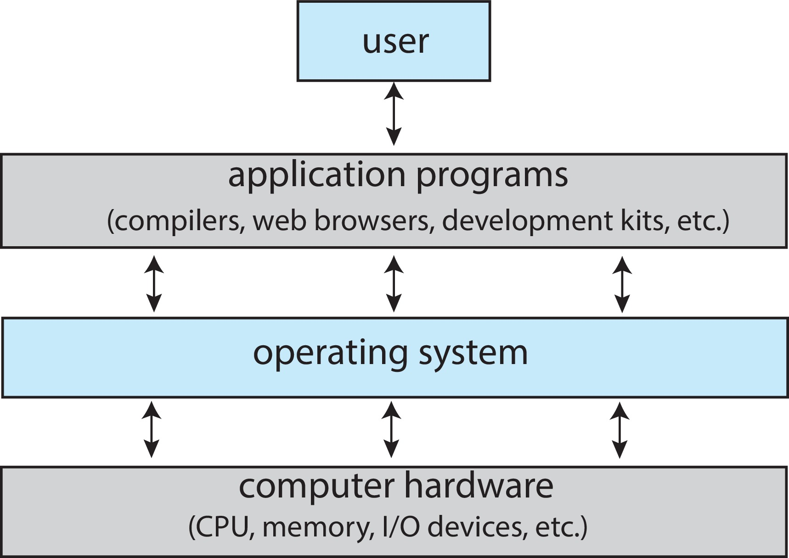
Abstract View of Components of Computer

Slide 8
What Operating Systems Do
Depends on the point of view
Users want convenience, ease of use and good performance
  Don’t care about resource utilization
But shared computer such as mainframe or minicomputer must keep all users happy
  Operating system is a resource allocator and control program making efficient use of HW and managing execution of user programs
Users of dedicate systems such as workstations have dedicated resources but frequently use shared resources from servers
Mobile devices like smartphones and tables are resource poor, optimized for usability and battery life
  Mobile user interfaces such as touch screens, voice recognition
Some computers have little or no user interface, such as embedded computers in devices and automobiles
  Run primarily without user intervention

Slide 9
Defining Operating Systems
Term OS covers many roles
  Because of myriad designs and uses of OSes
  Present in toasters through ships, spacecraft, game machines, TVs and industrial control systems
  Born when fixed use computers for military became more general purpose and needed resource management and program control

Slide 10
Operating System Definition
No universally accepted definition
“Everything a vendor ships when you order an operating system” is a good approximation
  But varies wildly
“The one program running at all times on the computer” is the kernel, part of the operating system
Everything else is either
  A system program (ships with the operating system, but not part of the kernel) , or
  An application program, all programs not associated with the operating system
Today’s OSes for general purpose and mobile computing also include middleware – a set of software frameworks that provide additional services to application developers such as databases, multimedia, graphics

Slide 11
Operating System Structure
General-purpose OS is very large program
Various ways to structure ones
  Simple structure – MS-DOS
  More complex – UNIX
  Layered – an abstraction
  Microkernel – Mach

Slide 12
Monolithic Structure – Original UNIX
UNIX – limited by hardware functionality, the original UNIX operating system had limited structuring.
The UNIX OS consists of two separable parts
  Systems programs
  The kernel
    Consists of everything below the system-call interface and above the physical hardware
    Provides the file system, CPU scheduling, memory management, and other operating-system functions; a large number of functions for one level

Slide 13
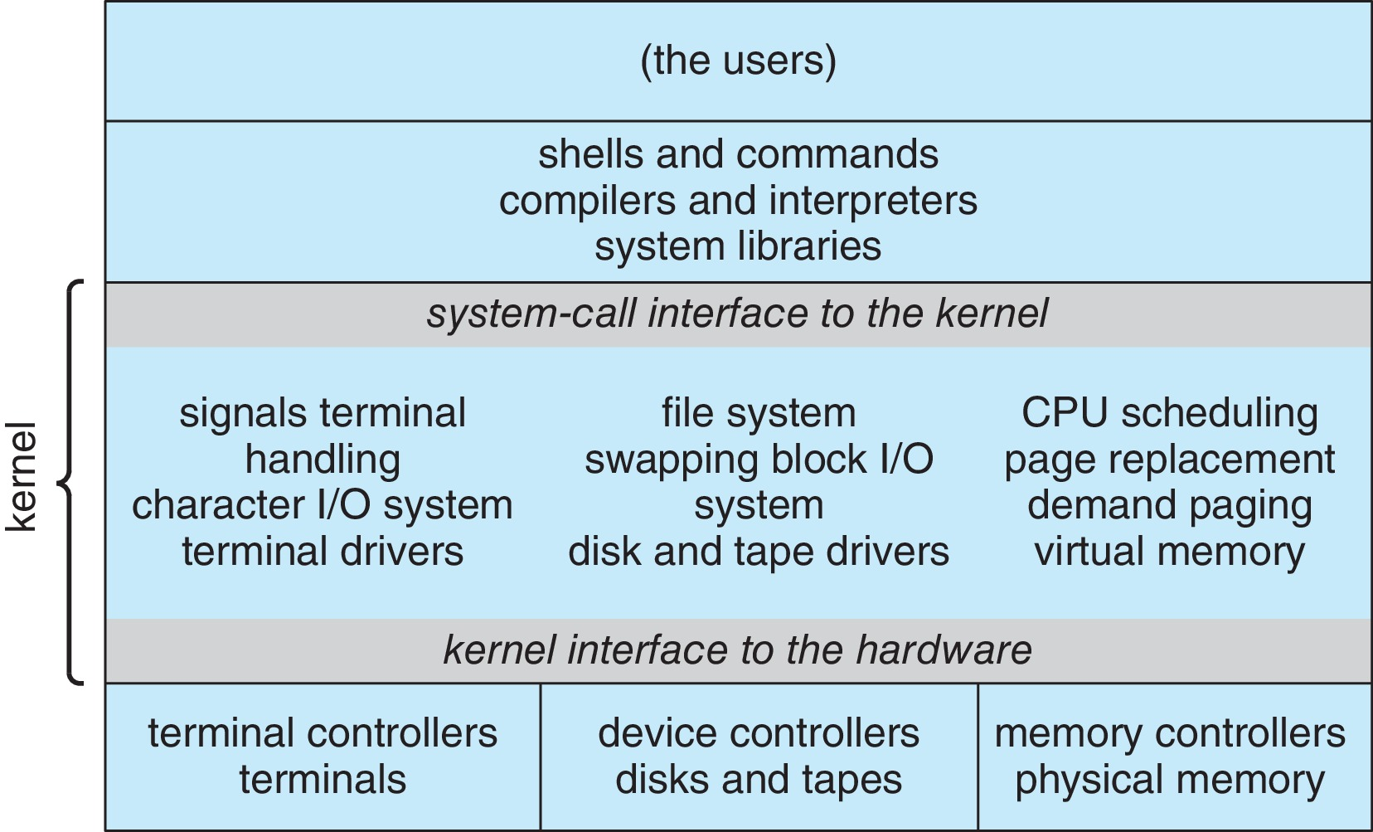
Traditional UNIX System Structure
Beyond simple but not fully layered

Slide 14
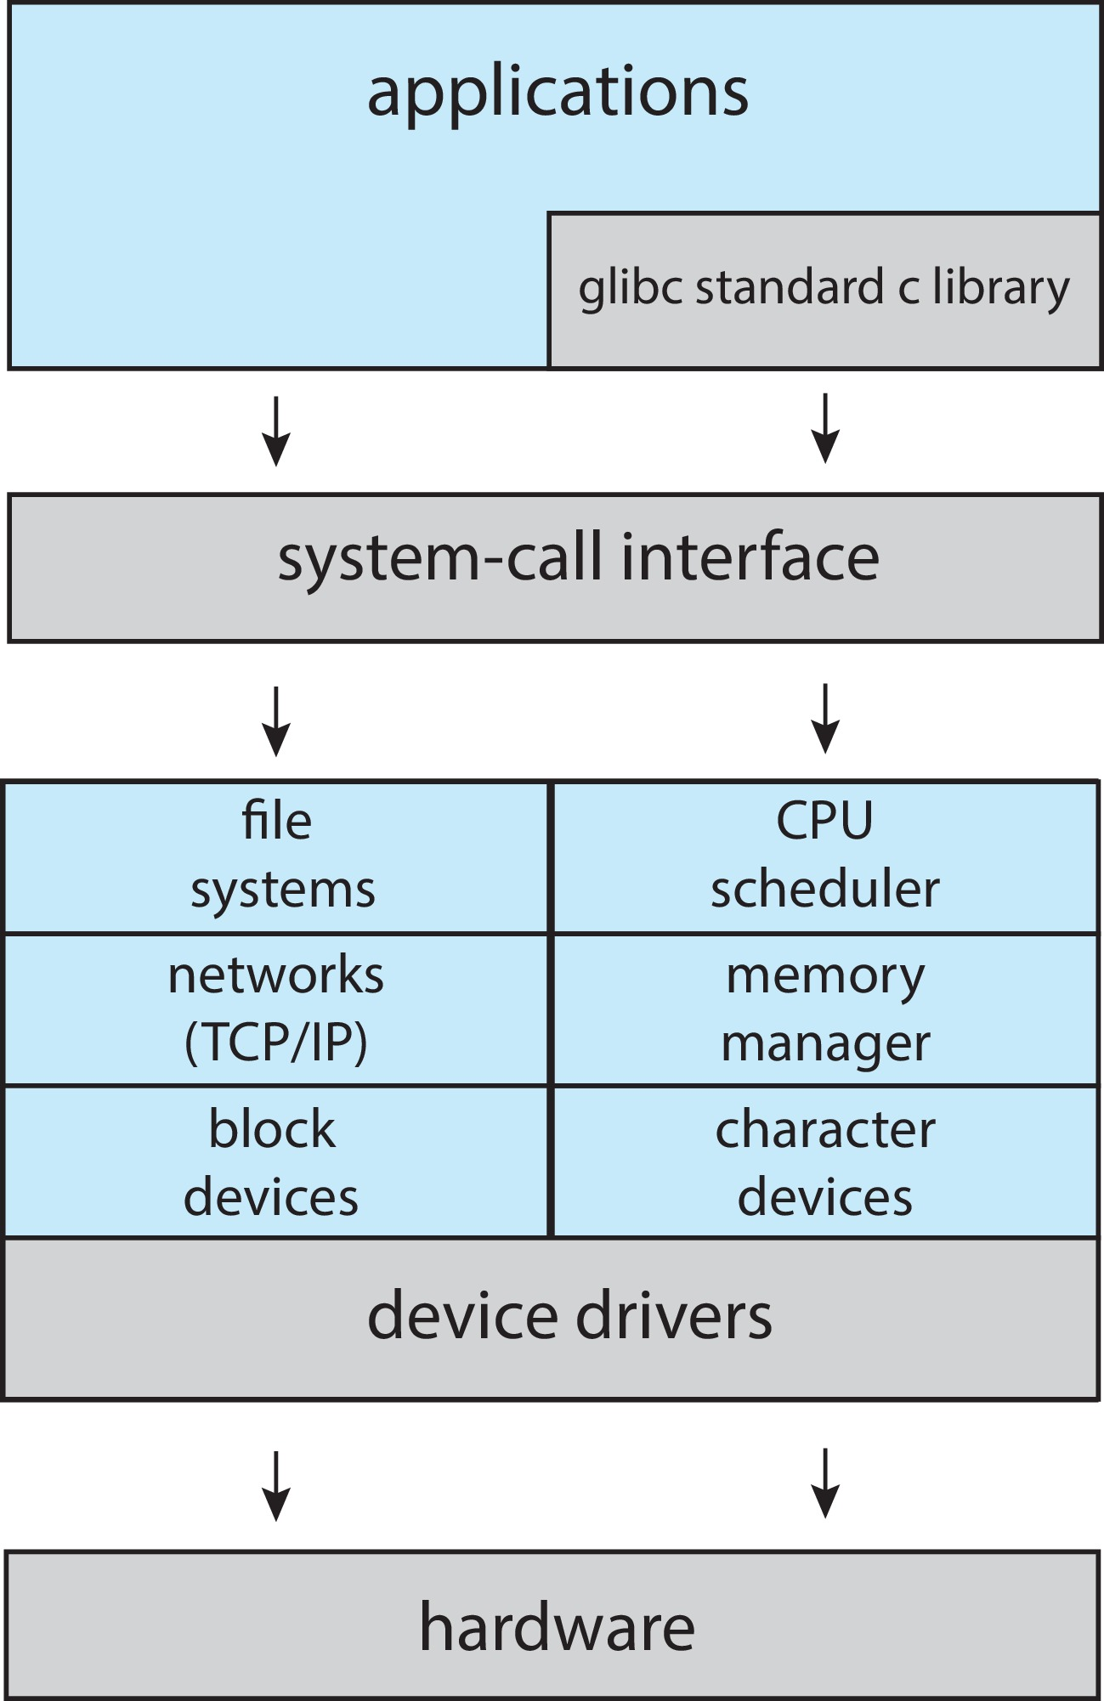
Linux System Structure
Monolithic plus modular design

Slide 15
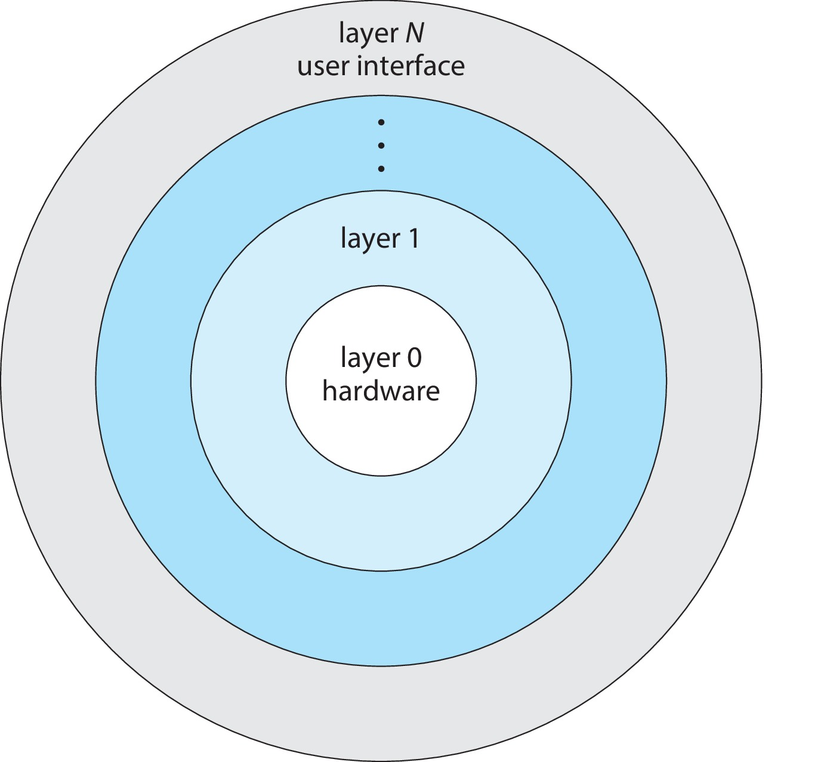
Layered Approach
The operating system is divided into a number of layers (levels), each built on top of lower layers. The bottom layer (layer 0), is the hardware; the highest (layer N) is the user interface.
With modularity, layers are selected such that each uses functions (operations) and services of only lower-level layers

Slide 16
Microkernels
Moves as much from the kernel into user space
Mach is an example of microkernel
  Mac OS X kernel (Darwin) partly based on Mach
Communication takes place between user modules using message passing
Benefits:
  Easier to extend a microkernel
  Easier to port the operating system to new architectures
  More reliable (less code is running in kernel mode)
  More secure
Detriments:
  Performance overhead of user space to kernel space communication

Slide 17
Microkernel System Structure

